Slide 1
3D Object Detection and Pose Estimation
Yu Xiang
University of Michigan
1st Workshop on Recovering 6D Object Pose
12/17/2015
Notes:
Good morning! I am going to talk about 3D object detection and pose estimation.

Slide 2
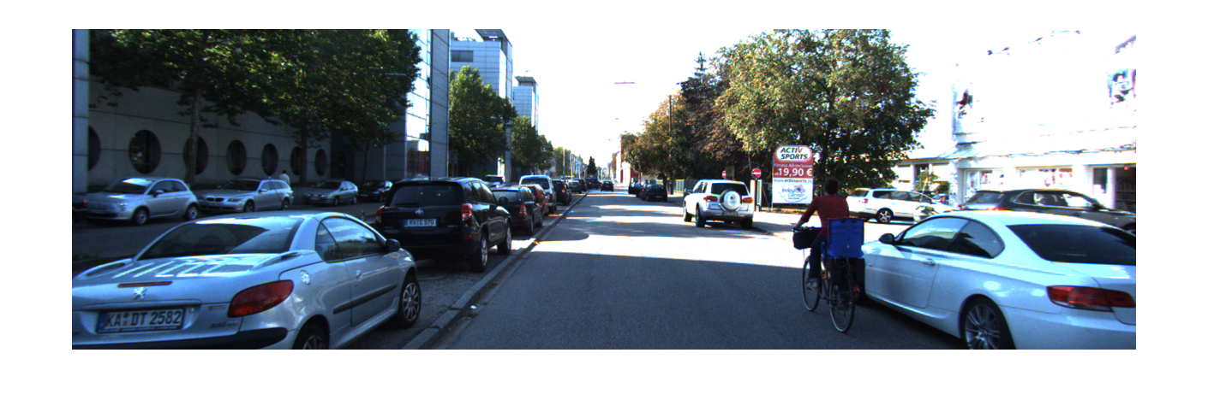
2D Object Detection
Notes:
Given an input image, 2D object detection methods focus on detecting objects with 2D bounding boxes.

Slide 3
2D detection is NOT enough!
Notes:
However, 2D object detection is not sufficient for many real world applications.

Slide 4
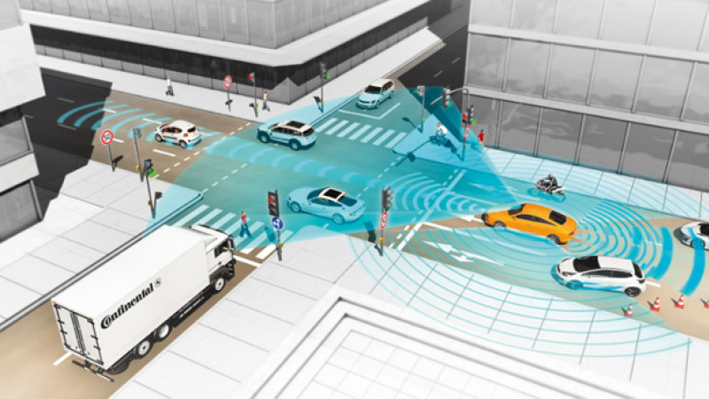
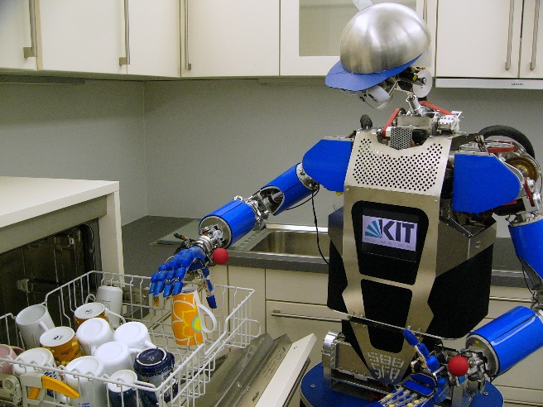
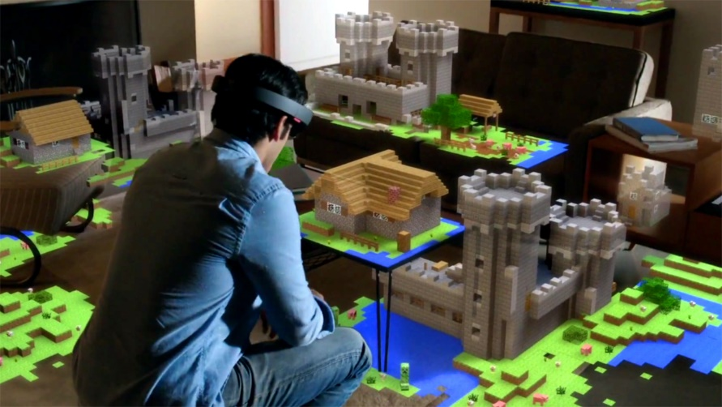
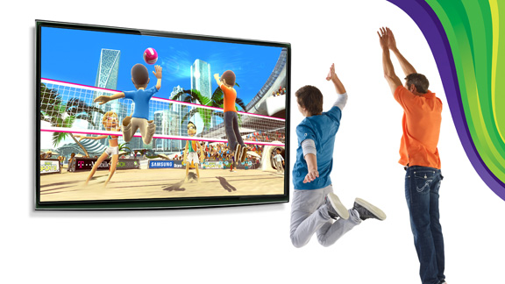
Applications that need 3D Object Detection
Autonomous Driving
Robotics
Any application that interacts with the 3D world!
Virtual Reality
Gaming
Notes:
There are many scenarios where we need to detect objects in the 3D world from input images, such as in autonomous driving, robotics, virtual reality and gaming. All these applications need to interact with the 3D world. That is why we need to detect objects and localize them in 3D. We argument that any application that interacts with the 3D world requires 3D object detection.

Slide 5
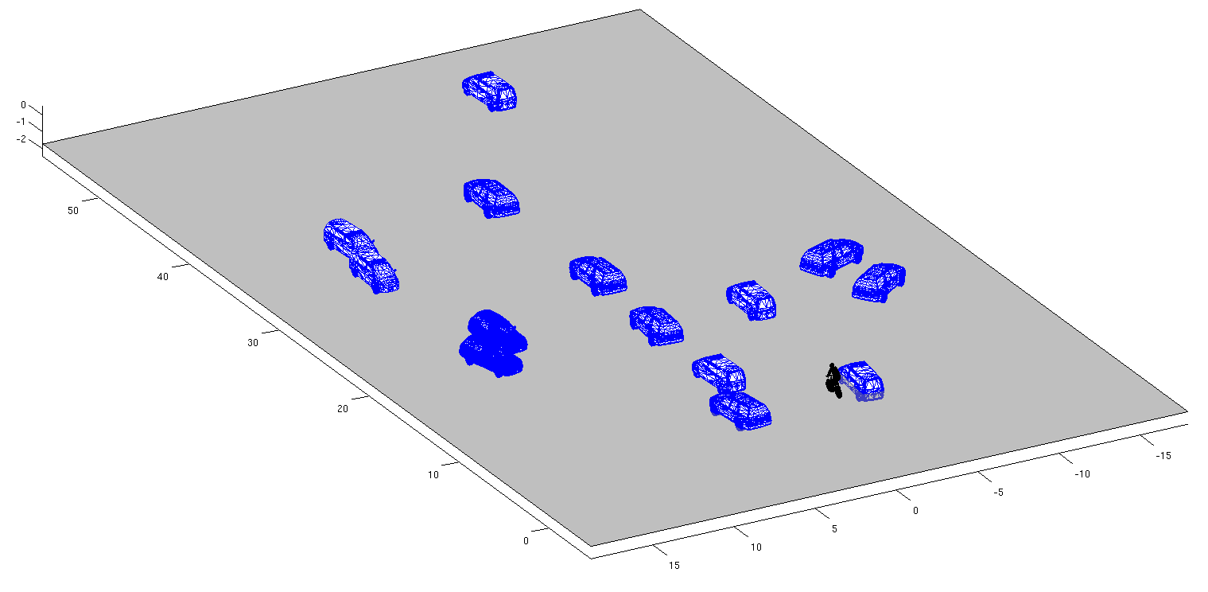
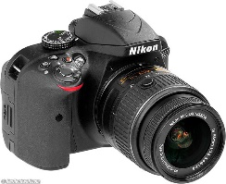
Goal: Infer the 3D World
Interaction
Control
Decision making
Navigation
Etc.
The 3D world
A 2D image
Notes:
A 2D image is a projection of the 3D world. Our goal is to infer the 3D world behind the scene. We focus on detecting objects and estimating their 3D poses that enables us to localize objects in 3D. 3D object detection is important if we want to interact with the 3D world, or conduct tasks such as control, decision making or navigation in 3D .

Slide 6
Our Work: 2D Object Detection
Notes:
We have developed object recognition methods that are able to accomplish the following tasks. Given a single input image

Slide 7
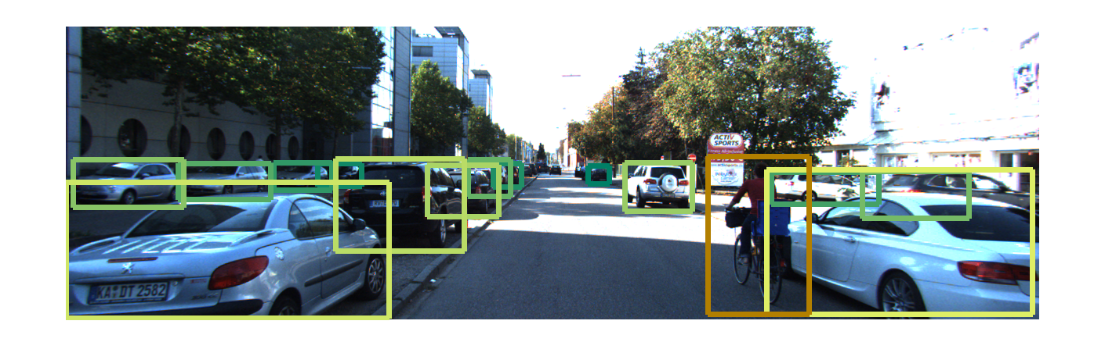
Our Work: 2D Object Detection
Notes:
Our method is able to detect objects in the image with 2D bounding boxes

Slide 8
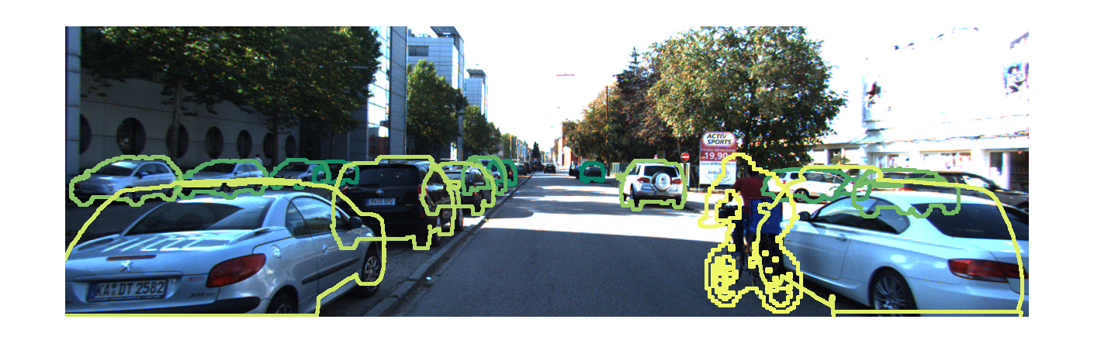
Our Work: 2D Object Segmentation
Notes:
Segment the boundaries of the objects

Slide 9
Our Work: Occlusion Reasoning
Notes:
And reason about occlusions between objects

Slide 10
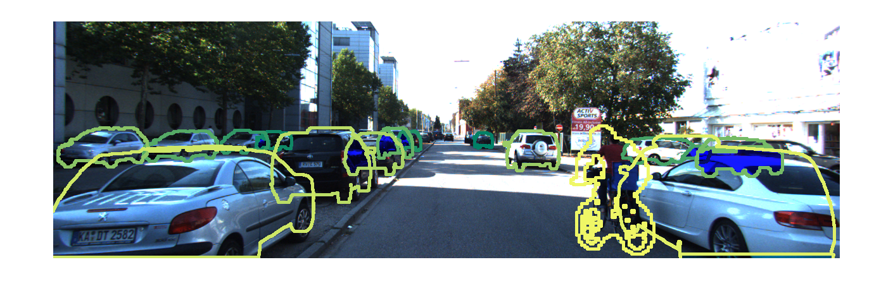
Our Work: Occlusion Reasoning
Notes:
The blue regions are the estimated occluded regions of the objects.

Slide 11
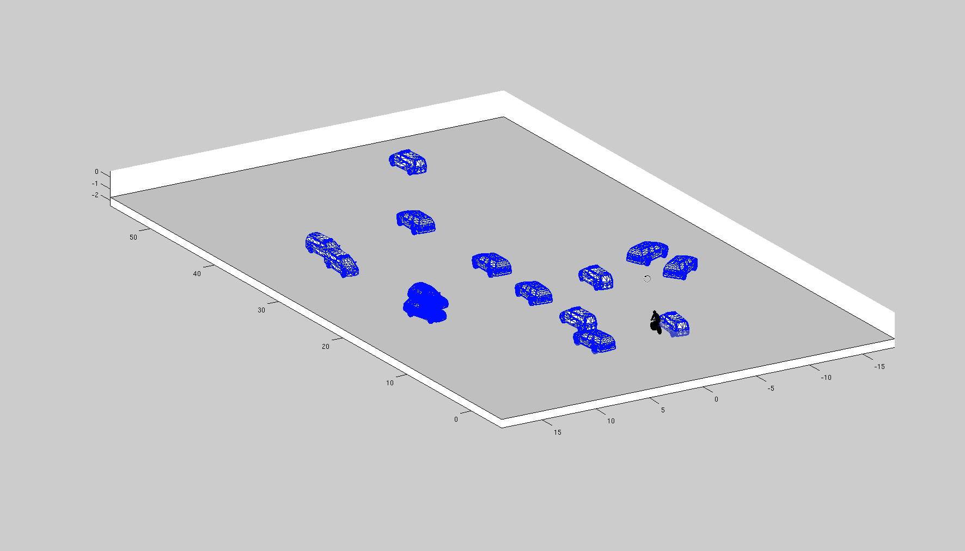
Our Work: 3D Localization
Notes:
Finally, we are able to back-project these objects into 3D, and localize them in the 3D space. This requires the object recognition method to accurately estimate the 3D location and the 3D pose of the object.

Slide 12
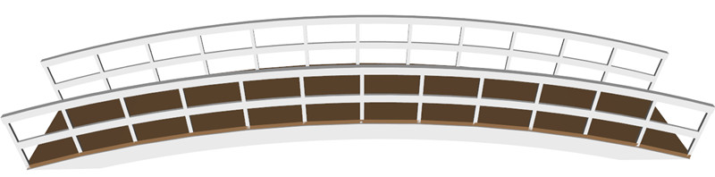
Contribution: 3D Object Representations
3D Object Representation
A 2D image
The 3D world
Notes:
My main contribution is that, I have proposed different 3D object representations, that enable us to infer the 3D world from just a single 2D image. These 3D object representations can be considered as a bridge to connect the 2D world with the 3D world.

Slide 13
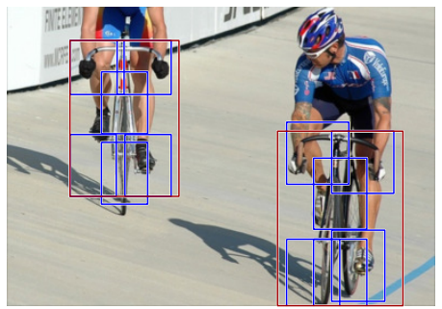
Related Work: 2D Object Representations
✓ 2D detection
✗ 3D pose
✗ Occlusion
✗ 3D location
Deformable part model
Felzenszwalb et al., TPAMI’10
Viola & Jones, IJCV’01
Fergus et al. , CVPR’03
Leibe et al., ECCVW’04
Hoiem et al., CVPR’06
Vedaldi et al., ICCV’09
Maji & Malik, CVPR’09
Felzenszwalb et al., TPAMI’10
Malisiewicz et al., ICCV’11
Divvala et al., ECCVW’12
Dolla´r et al., TPAMI’14
Etc.
Notes:
In the literature, different object representations have been proposed. 2D object representation based methods focus on recognizing objects as 2D bounding boxes. These methods are not able to estimate the 3D pose of objects, reason about occlusions between objects, nor localize objects in 3D.

Slide 14
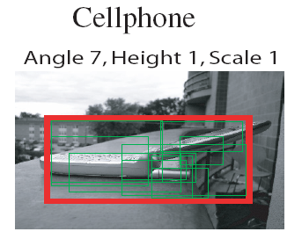
Related Work: 2.5D Object Representations
✓ 2D detection
✓ 3D pose
✗ Occlusion
✗ 3D location
Savarese & Fei-Fei ICCV’07
Thomas et al., CVPR’06
Savarese & Fei-Fei ICCV’07
Kushal et al., CVPR’07
Su et al., ICCV’09
Sun et al., CVPR’10
Etc.
Notes:
2.5D object representations represent objects as collections of parts or features that are connected across views. As a results, 2.5D representation based methods are able to jointly detect the objects in images and estimate their 3D pose. However, they are not able to handle occlusion between objects, nor localize objects in 3D.

Slide 15
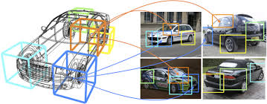
Related Work: 3D Object Representations
✓ 2D detection
✓ 3D pose
✗ Occlusion
✗ 3D location
3DDPM
Pepik et al., CVPR’12
Yan et al., ICCV’07
Hoiem et al., CVPR’07
Liebelt et al., CVPR’08, 10
Glasner et al. ICCV’11
Pepik et al., CVPR’12
Xiang & Savarese, CVPR’12
Hejrati & Ramanan, NIPS’12
Fidler et al., NIPS’12
Etc
Notes:
Different 3D object representations have also been proposed. But most of these works focus on joint detection and 3D pose estimation. They are not able to handle occlusion, nor accurately localize objects in 3D.

Slide 16
Contribution: 3D Object Representations
✓ 2D detection
✓ 3D pose
✓ Occlusion
✓ 3D location
Notes:
Unlike previous works, I have proposed new 3D object representations which enable us to detect objects in images, estimate their 3D pose, reason about occlusions between them, and localize the detected objects in 3D.

Slide 17
Outline
3D Aspect Part Representation
3D Aspectlet Representation
3D Voxel Pattern Representation
Conclusion and Future Work
Notes:
Here is the outline of my following talk.

Slide 18
Outline
3D Aspect Part Representation
3D Aspectlet Representation
3D Voxel Pattern Representation
Conclusion and Future Work
Notes:
Let me start with the 3D aspect part representation.

Slide 19
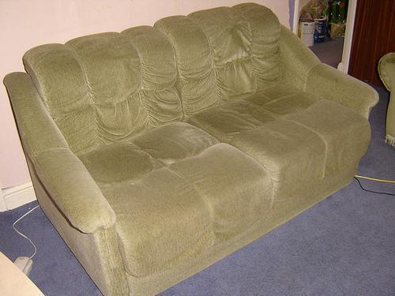
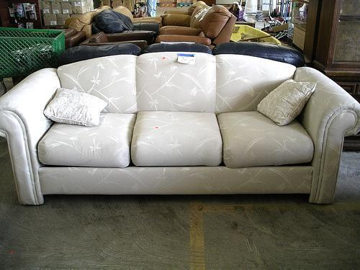
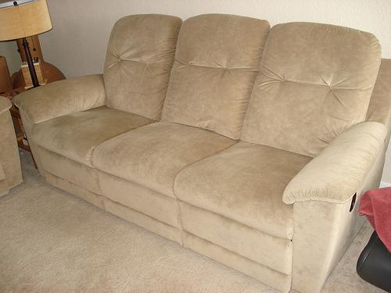
3D Aspect Part Representation
Viewpoint Variation
Notes:
In this work, I focus on recognizing objects from different viewpoints.
As we can see from the three images, the appearance of object changes according to the viewpoint.
So we propose the 3D aspect part representation to handle the viewpoint variation.

Slide 20
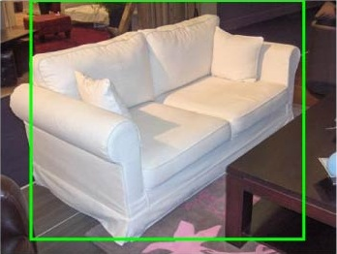
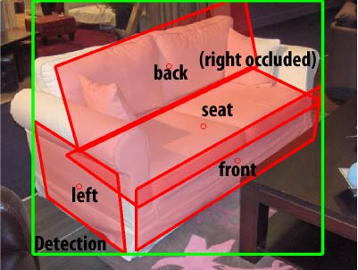
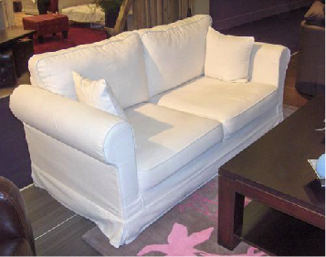

3D Aspect Part Representation
Viewpoint: Azimuth 315˚, Elevation 30˚, Distance 2
Y. Xiang and S. Savarese. Estimating the aspect layout of object categories. In CVPR, 2012.
Notes:
Based on the 3D aspect part representation, give an input image, our method is able to detect objects in the input image, estimate the 3D pose of the object, and localize the 3D aspect parts of the object in the image.

Slide 21
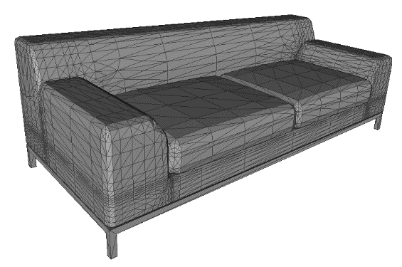
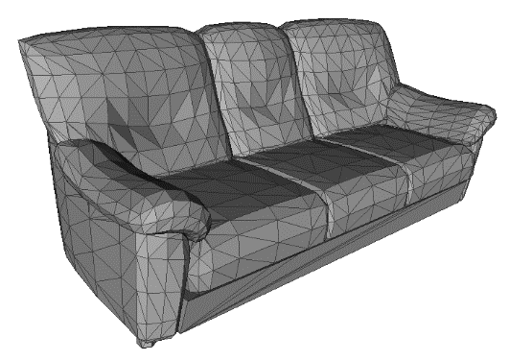
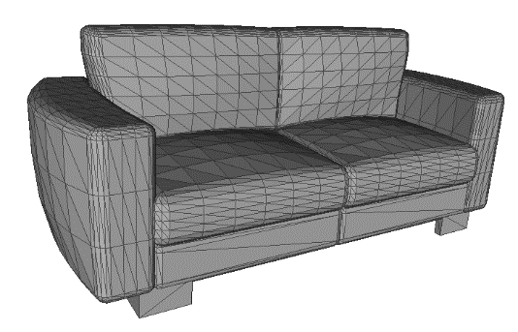
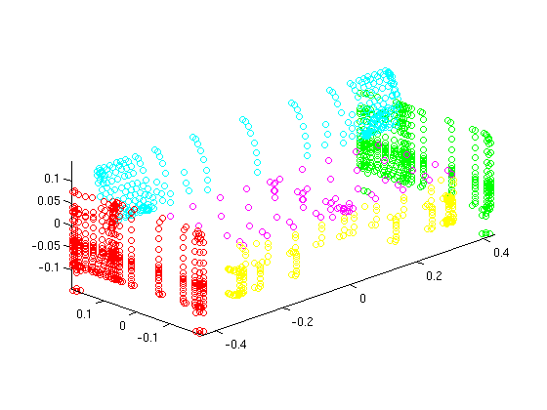
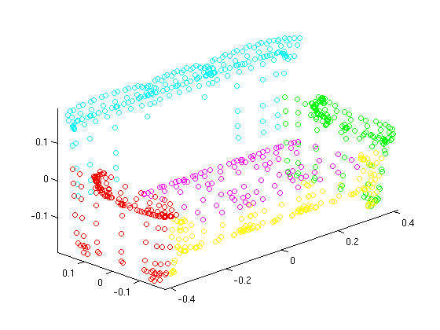
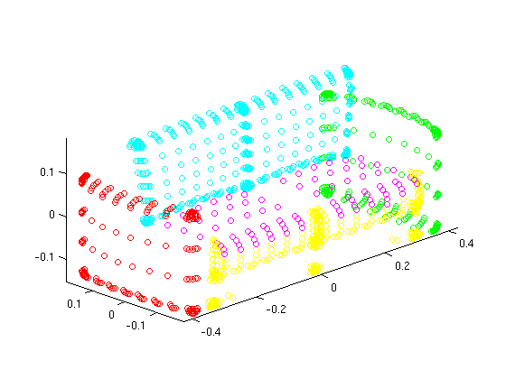
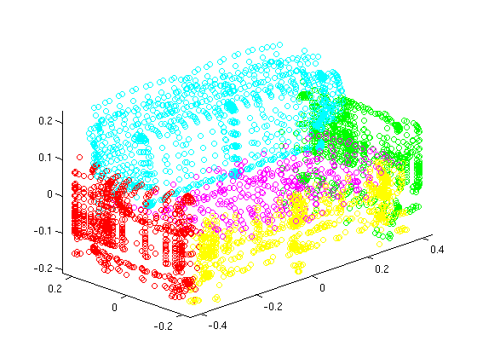
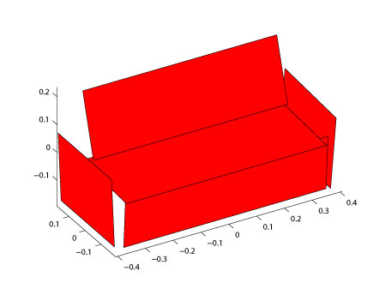
3D Aspect Parts from 3D CAD Models
…
…
Mean Shape
Notes:
We build the 3D aspect parts of an object category from 3D CAD models. Given a set of 3D CAD models, we first segment the 3D points of these models into planar surfaces. Then we aggregate all the 3D points from all the CAD models to obtain the mean shape of the category. Finally, we fit a 3D rectangle to each set of 3D points, and each 3D rectangle is called a 3D aspect part. Here is the 3D aspect part representation for sofa.

Slide 22
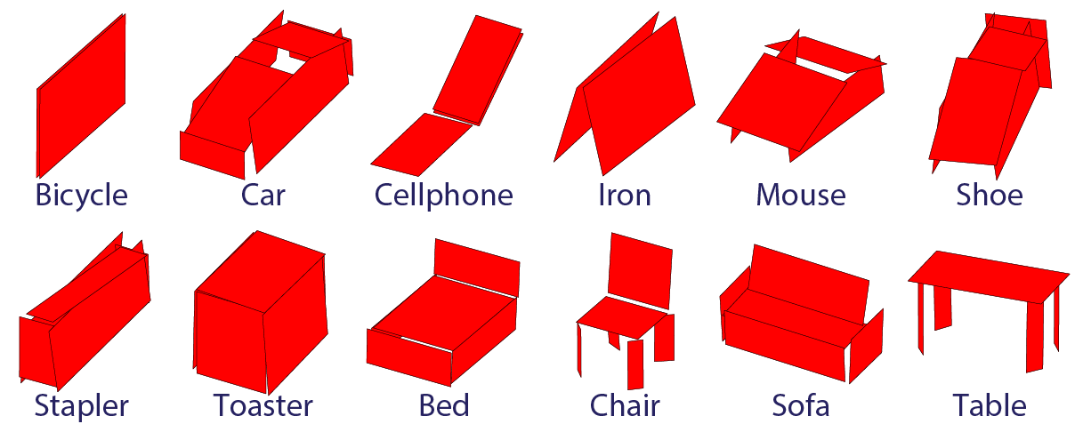
3D Aspect Part Representation
Notes:
Here are the 3D aspect part representations for 12 categories in our experiments.

Slide 23
Aspect Layout Model
Viewpoint: Azimuth 315˚, Elevation 30˚, Distance 2
Aspect Layout Model
An input image
Output
3D aspect part representation
Notes:
Based on the 3D aspect part representation, we propose an aspect layout model for object recognition. The aspect layout model takes two inputs. The first one is an input image, and the second one is the 3D aspect part model we have built. The output consists of the 2D bounding box of the object, the pose or viewpoint of the object, and the 3D aspect part location in the input image.

Slide 24
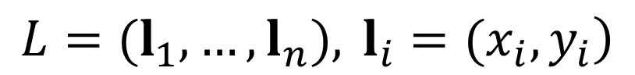
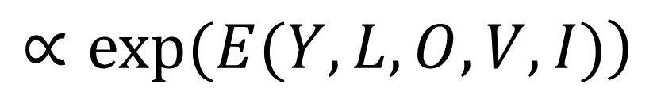
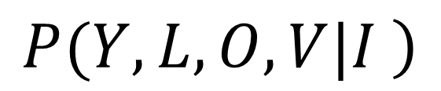
Aspect Layout Model
Posterior distribution
$$\left.P(Y,L,O,V|I \right)$$
$$\left.∝exp(E(Y,L,O,V,I)\right)$$
2D part center
coordinates
object label
3D object
viewpoint
$$\left.L=(l_{1},…,l_{n}), l_{i}=(x_{i},y_{i}\right)$$
Notes:
Given an input image, we model the posterior of object label, 2D part center coordinates, 3D objects and viewpoint given an input image.

Slide 25
Aspect Layout Model
Energy function
unary potential
pairwise potential
Notes:
The energy function is decomposed into unary potential and pairwise potential. The unary potential capture the part appearance of a single part, and the pairwise potential models the relationship between two parts.

Slide 26
Aspect Layout Model
Unary potential
part template
feature vector
self-occlusion weight
Notes:
The unary potential is defined as the dot product between the part template and the feature vector extracted for the part if the part is visible. If the part is self-occluded, we assign a weight alpha as the unary potential. Both the part templates and the self-occlusion weights are learned from training data.

Slide 27
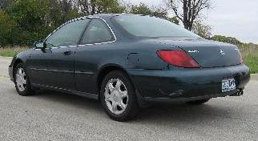
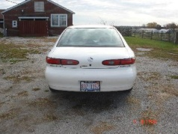
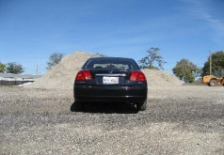
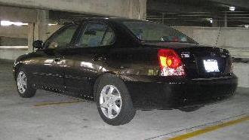
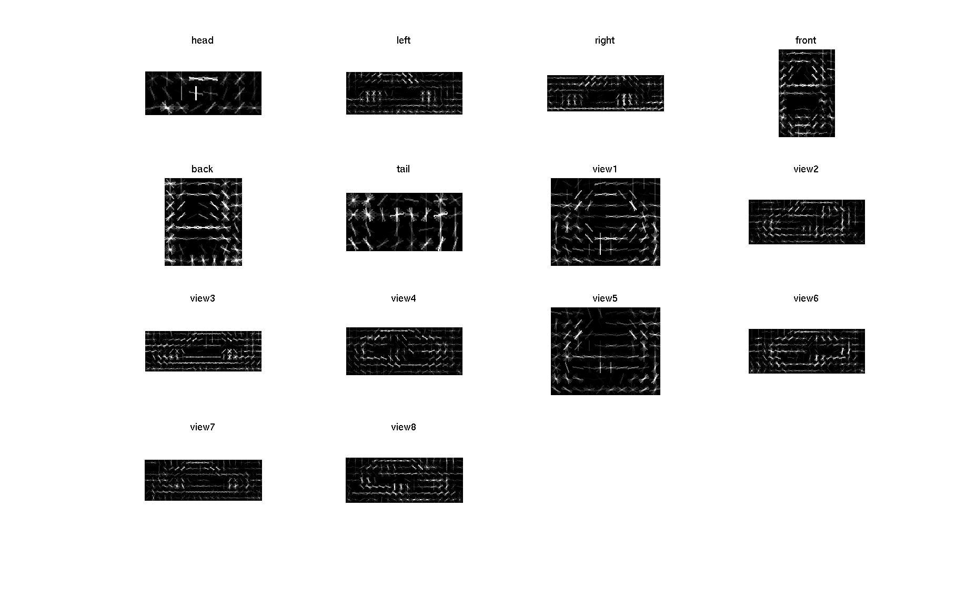
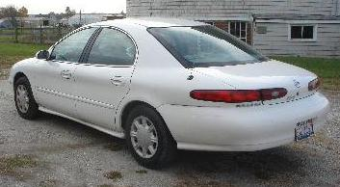
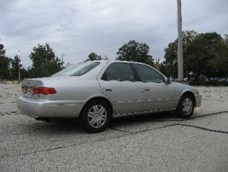
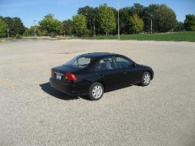
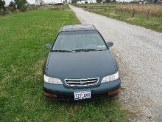
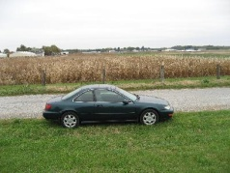
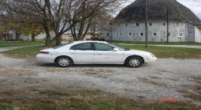
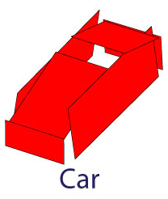
Aspect Layout Model
Head
Tail
Back
Left
Right
Front
Root3
Root4
Root1
Root2
Root5
Root6
Root7
Root8
Notes:
The HOG templates for the 3D aspect parts of car learnt in our experiments.

Slide 28
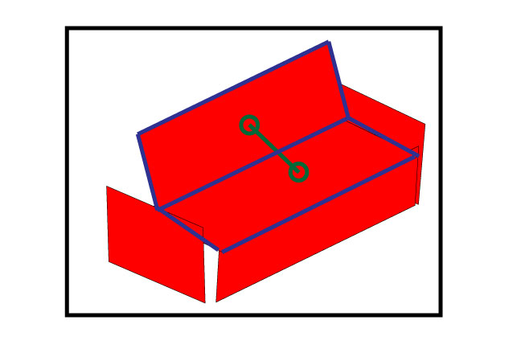
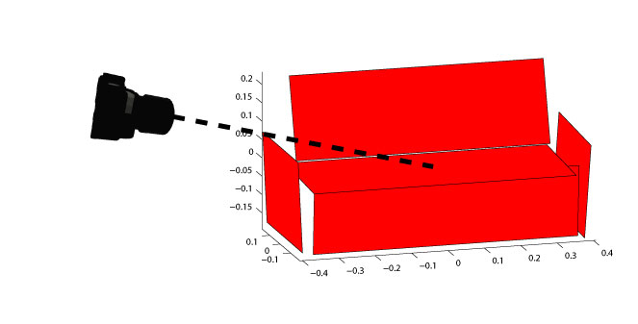
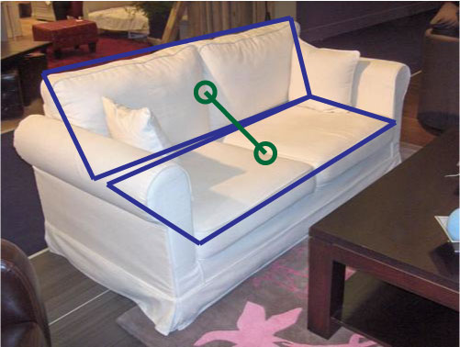
Aspect Layout Model
Pairwise potential
2D projection
3D world
2D observation
Notes:
The pairwise potential constraints that the actually locations of the two parts in the images should be similar to the projection from the 3D object model.

Slide 29
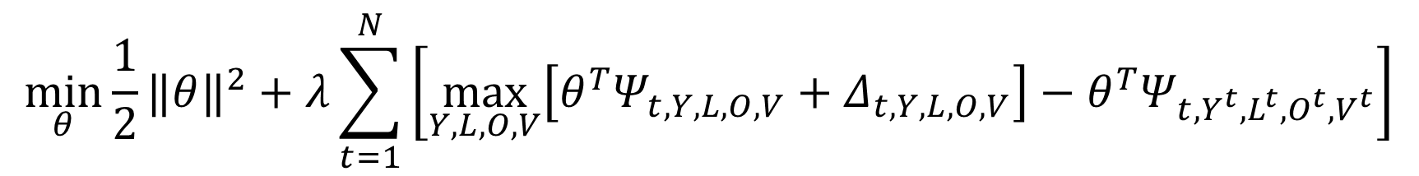
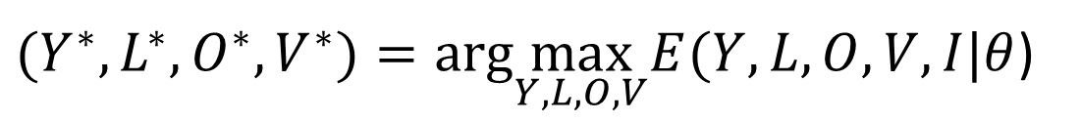
Aspect Layout Model
Training with Structural SVM [1]
Inference
Loop over discretized viewpoints
Run Belief Propagation [2] under each viewpoint to predict part locations
$$\min_{θ}\frac{1}{2}{‖θ‖}^{2}+λ\sum_{t=1}^{N}{\left[\max_{Y,L,O,V}\left[θ^{T}Ψ_{t,Y,L,O,V}+Δ_{t,Y,L,O,V}\right]−θ^{T}Ψ_{t,Y^{t},L^{t},O^{t},V^{t}}\right]}$$
$(Y^{∗},L^{∗},O^{∗},V^{∗})=arg\max_{Y,L,O,V}E(Y,L,O,V,I|θ$)
[1] I. Tsochantaridis, T. Hofmann, T. Joachims and Y. Altun. Support vector machine learning for interdependent and structured output spaces. In ICML, 2004.
[2] J. S. Yedidia, W. T. Freeman, and Y. Weiss. Understanding belief propagation and its generalizations. In Exploring artificial intelligence in the new millennium, 2003.
Notes:
Training and inference.

Slide 30
Aspect Layout Model
Best results upon publication in pose estimation and 3D part estimation
Cars from
3D Object dataset
[Savarese & Fei-Fei ICCV’07]
Method | Ours | [1] | [2] | [3] | [4] | [5] | [6]
Viewpoint (cars) | 93.4% | 85.4 | 85.3 | 81 | 70 | 67 | 48.5
Cars from
EPFL dataset
[Ozuysal et al. CVPR’09]
Method | Ours | Ours - baseline | DPM [7] | [8]
Viewpoint (cars) | 64.8% | 58.1 | 56.6 | 41.6
Chairs, tables, sofas and beds
from IMAGE NET
[Deng et al. CVPR’09]
Method | Ours | Ours - baseline | DPM [7]
Viewpoint | 63.4% | 34.0 | 49.5
[1] N. Payet and S. Todorovic. From contours to 3d object detection and pose estimation. In ICCV, 2011.
[2] D. Glasner, M. Galun, S. Alpert, R. Basri, and G. Shakhnarovich. Viewpoint-aware object detection and pose estimation. In ICCV, 2011.
[3] M. Stark, M. Goesele, and B. Schiele. Back to the future: Learning shape models from 3d cad data. In BMVC, 2010.
[4] J. Liebelt and C. Schmid. Multi-view object class detection with a 3D geometric model. In CVPR, 2010.
[5] H. Su, M. Sun, L. Fei-Fei, and S. Savarese. Learning a dense multiview representation for detection, viewpoint classification. In ICCV, 2009.
[6] M. Arie-Nachimson and R. Basri. Constructing implicit 3d shape models for pose estimation. In ICCV, 2009.
[7] P. Felzenszwalb, R. Girshick, D. McAllester, and D. Ramanan. Object detection with discriminatively trained part-based models. TPAMI, 2010.
[8] M. Ozuysal, V. Lepetit, and P. Fua. Pose estimation for category specific multiview object localization. In CVPR, 2009.

Slide 31






Aspect Layout Model
Prediction: a=225, e=30, d=7
Prediction: a=330, e=15, d=7
Prediction: a=150, e=15 d=7
Prediction: a=45, e=90, d=5
Prediction: a=300, e=45 d=23
Prediction: a=240, e=45, d=11

Slide 32






Aspect Layout Model
Prediction: a=0, e=15, d=1.5
Prediction: a=0, e=30, d=7
Prediction: a=30, e=15, d=2.5
Prediction: a=345, e=15, d=3.5
a=60, e-30, d=2.5
Prediction: a=315, e=30, d=2
Prediction: a=60, e=15, d=2
ImageNet dataset [Deng et al. 2010]

Slide 33




Wrong examples
Prediction: a=45, e=15, d=1.5
Prediction: a=225, e=30, d=7
Prediction: a=0, e=30, d=7
Prediction: a=345, e=15 d=2.5
Notes:
These errors are due to the appearance ambiguity. The viewpoint is not estimated correctly.

Slide 34



Application I: Object Co-detection with 3D Aspect Parts
Single Image Detector
Co-detector
Shoe model
S. Bao, Y. Xiang and S. Savarese. Object Co-detection. In ECCV, 2012.
Notes:
We have applied the 3D aspect part representation to two important applications. The first one is object co-detection. Given a pair of images, the goal of co-detection is to detect objects in both images and match the detected objects if they are the same object instance. We have proposed a novel object co-detector. Compare to single image detectors, our co-detector achieves better detection performance. In additional, it establishes the correspondences between the detected objects using our 3D aspect part representation.

Slide 35




Application II: Multiview Object Tracking with 3D Aspect Parts
Frame 9
Azimuth=315.48
Elevation=4.56
Distance=4.98
Frame 29
Azimuth=1.34
Elevation=2.78
Distance=6.58
Frame 69
Azimuth=89.12
Elevation=3.73
Distance=2.34
Frame 48
Azimuth=25.17
Elevation=3.60
Distance=3.56
Y. Xiang, C. Song, R. Mottaghi and S. Savarese. Monocular Multiview Object Tracking with 3D Aspect Parts. In ECCV, 2014.
Notes:
Another application is multiview object tracking. The goal is to track an object in a video, where the viewpoint of the object may change. In this example, the car turns, so its viewpoint changes. In this work, we propose a novel monocular multiview object tracker. First, our method is able to track the 2D location of the target in videos from a single camera. Second, it is able to estimate the continuous viewpoint of the target in time. Third, it also localizes the 3D aspect parts of the target in time.

Slide 36


Application II: Multiview Object Tracking with 3D Aspect Parts
Ours: Multiview tracker
MIL
L1
TLD
Struct
[MIL] Babenko, B., Yang, M.H., Belongie, S.: Robust object tracking with online multiple instance learning. TPAMI, 2011.
[L1] Bao, C., Wu, Y., Ling, H., Ji, H.: Real time robust l1 tracker using accelerated proximal gradient approach. In CVPR, 2012.
[TLD] Kalal, Z., Mikolajczyk, K., Matas, J.: Tracking-learning-detection. TPAMI, 2012.
[Struct] Hare, S., Saari, A., Torr, P.H.: Struck: Structured output tracking with kernels. In ICCV, 2011.
Notes:
We compare our mulitview tracker with four state-of-the-art single object trackers. As you can see from these results videos, when the car changes its viewpoint, all the four single object trackers fail to track the car, since they are not able to handle the viewpoint variation. While our multi-view object tracker successfully track the car, and estimate the continuous viewpoint transformation.

Slide 37
Outline
3D Aspect Part Representation
3D Aspectlet Representation
3D Voxel Pattern Representation
Conclusion and Future Work
Notes:
Next, I am going to talk about the 3D aspectlet representation.

Slide 38

Occlusion in Object Recognition
？
Occlusion changes the appearances of objects.
Notes:
Let’s first consider occlusions in object recognition. Given this test image, our aspect layout model is able to detect the white car and the black car confidently. But for the blue car, it may get confused. The reason is that the blue car is occluded, its appearance is not like the cars in the training images. Occlusion changes the appearances of objects. Modeling occlusion in object recognition is important.

Slide 39



3D Aspectlet Representation
3D Aspect Parts
Atomic 3D Aspect Parts
Y. Xiang and S. Savarese. Object Detection by 3D Aspectlets and Occlusion Reasoning. In 3dRR, 2013.
Notes:
I have introduced the 3D aspect part representation. 3D Aspect part is good at handling self-occlusion, but not good for occlusions between objects. The reason is that, in real world scenes, a 3D aspect part is usually partially occluded. As a results, some features for detecting the aspect part can be missing.
So we propose to decompose an 3D aspect part into several smaller parts that we call atomic 3D aspect parts. As a result, we can approximately treat each atomic 3D aspect parts as either occluded or visible.

Slide 40


3D Aspectlet Representation
3D Aspectlets
Notes:
However, atomic 3D aspect parts are harder to detect, since we may lack of enough visual features to detect them. We propose to group atomic 3D aspect parts to form bigger parts, which we call 3D aspectlets. Then we train a detector for each 3D aspectlet. Here are some detection results from our 3D aspectlet detectors.

Slide 41


3D Aspectlet Representation
Notes:
Other examples on bed, chair, sofa and table.

Slide 42
Object Detection Experiments
Dataset | Outdoor-scene |  |  | Indoor-scene
% occlusion | < 0.3 | 0.3 – 0.6 | > 0.6 | <0.2 | 0.2-0.4 | >0.4
# images | 66 | 68 | 66 | 77 | 111 | 112
ALM [1] | 72.3 | 42.9 | 35.5 | 38.5 | 25.0 | 20.2
DPM [2] | 75.9 | 58.6 | 44.6 | 38.0 | 22.9 | 21.9
Ours 3D Aspectlets | 80.2 | 63.3 | 52.9 | 45.9 | 34.5 | 28.0
[1] Y. Xiang and S. Savarese. Estimating the aspect layout of object categories. In CVPR, 2012.
[2] P. F. Felzenszwalb, R. B. Girshick, D. McAllester, and D. Ramanan. Object detection with discriminatively trained part-based models. TPAMI, 2010.
Notes:
In terms of experiments, we have evaluated our 3D aspectlet representation based approach on a outdoor scene dataset for car detection, and an indoor scene dataset for detecting bed, chair, sofa and table. We evaluate the detection performance according to different degrees of occlusion. Compare to our aspect layout model and the deformable part model, we achieve better detection accuracy in different occlusion levels. The margin of the severe occlusion case is much more significant.

Slide 43


Object Detection Experiments
Outdoor Scenes
Indoor Scenes

Slide 44
Outline
3D Aspect Part Representation
3D Aspectlet Representation
3D Voxel Pattern Representation
Conclusion and Future Work
Notes:
Then let’s me talk about the 3D voxel pattern representation.

Slide 45






What are the 3D aspect parts for aeroplane and bottle?
Notes:
As you may have noticed, 3D aspect parts are not good at representing objects with complex geometry. For example, for aeroplane and bottle, it is not easy to come up with their 3D aspect part representation. A more general way to represent 3D shape is to use voxels.

Slide 46







Data-Driven 3D Voxel Patterns
✓ 2D detection
✓ 3D pose
✓ Occlusion
✓ 3D location
Y. Xiang, W. Choi, Y. Lin and S. Savarese. Data-Driven 3D Voxel Patterns for Object Category Recognition. In CVPR, 2015.
Notes:
We introduce a novel 3D voxel pattern representation. It enables us to not only detect the objects in the image, but also segment the boundary of the object, estimate the occluded regions of the object, and finally localize objects in 3D. For each car in this example, it has an associated 3D voxel pattern. In this representation, green voxels are visible, red voxels are occluded by other objects, and cyan voxels are truncated by image borders. All these patterns are discovered in a data-driven way, and used for recognition.

Slide 47
















Training Pipeline Overview
…
1. Align 2D images with 3D CAD models
2. 3D voxel exemplars
…
…
4. Training 3D voxel pattern detectors
3. 3D voxel patterns
Notes:
In our training pipeline, we first align objects in 2D images with 3D CAD models.
Using the 2D-3D alignment, we introduce a new representation called 3D voxel exemplar for the object, which encodes information about the 2D appearance, 3D shape and 3D pose, truncation and occlusion of the object.
Then we cluster 3D voxel exemplars in the 3D voxel space to group objects with similar visibility pattern, and we call each cluster a 3D voxel pattern (3DVP).
Finally, we train a detector for each 3D voxel pattern. Our 3D voxel representation enables us to discover subcategories with compact 2D appearance. So we can train a good detector for each pattern.

Slide 48






1. Align 2D Images with 3D CAD Models
…
3D annotations
Project of 3D CAD models
3D CAD models
Depth ordering
A. Geiger, P. Lenz, and R. Urtasun. Are we ready for autonomous driving? the kitti vision benchmark suite. In CVPR, 2012
Notes:
We first align objects in 2D images with corresponding 3D CAD models in order to build our 3D voxel representation.
We illustrate our recognition pipelines with the KITTI benchmark for car recognition.
In training, each car in KITTI is annotated by a 3D cuboid. So we automatically choose a 3D car model and fit it into the 3D cuboid to align 2D objects with 3D CAD models. After the alignment, we project all the 3D car models using the ground truth camera parameters provided by KITTI as well. So we obtain the depth ordering of all the objects in the scene.

Slide 49



2. Building 3D Voxel Exemplars
3D CAD model
Depth ordering
Voxelization
self-occluded
visible
occluded
truncated
truncated
occluded
visible
2D mask labeling
3D voxel model
Notes:
Using the 2D-3D alignment, we build 3D voxel exemplars to encode different properties of objects.
From the depth ordering map, we automatically classify each pixel of a car into visible, occluded or truncated.
In 3D, we voxelize the 3D car model, and transfer the labeling from the 2D mask to the 3D voxel model.
As in the 2D mask labeling, we use green to label visible voxels, red to label occluded voxels, and cyan to label truncated voxels.
In addition, we color voxels which are self-occluded by blue.
As a result, our voxel labeling encodes information about the 3D shape and 3D pose, truncation and occlusion of the object in a unified 3D space.

Slide 50

2. Building 3D Voxel Exemplars
A 3D voxel exemplar
$$\left.E_{i}=(I_{i},M_{i},V_{i}\right)$$
2D segmentation mask
2D image
3D voxel model
Notes:
Finally, we construct a 3D voxel exemplar for each object, which is a triplet of the 2D image, the 2D segmentation mask and the 3D voxel model of the object.

Slide 51


















3D Voxel Exemplars
3. Discovering 3D Voxel Patterns
…
Clustering in 3D voxel space
3D Voxel Patterns (3DVPs)
Notes:
From the training set, we construct a large number of 3D voxel exemplars. Then we cluster them to discover 3D voxel patterns.
The clustering is performed in the 3D voxel space using the voxel labeling.
As a result, our clustering algorithm groups objects with similar visibility patterns, and we call each cluster a 3D voxel pattern (3DVP).
From the KITTI training set, we have discovered more than 57,000 3D voxel exemplars, and cluster them into more than 200 clusters.

Slide 52








4. Training 3D Voxel Pattern detectors
$$D_{1}$$
$$D_{2}$$
…
…
$$D_{K}$$
Train a ACF detector for each 3DVP.
P. Dollár, R. Appel, S. Belongie, and P. Perona. Fast feature pyramids for object detection. TPAMI, 2014.
Notes:
The last stage of our training pipeline is to train 3DVP detectors.
We train a detector for each 3DVP such that the detector is designed to detect that specific pattern.
Each 3DVP has compact 2D appearance, which enables us to train a good detector for it.
Specifically, we employ the ACF detector proposed by Dollar et al, which works well on the KITTI benchmark for car recognition.

Slide 53
4. Training 3D Voxel Pattern detectors
Region proposals
Class loss
Bounding box
Regression loss
Input image
5 Conv layers
Feature extraction
RoI pooling
layer
FC6
(4096)
FC7
(4096)
FC8
(228)
Subcategory loss
Train a Convolutional Neural Network (CNN) for 3DVPs.
Under review
Notes:
Instead of training a ACF detector for each 3D voxel pattern, recently, we proposed to train a Convolutional Neural Network (CNN) to detect 3DVPs. The CNN-based approach is more efficient and achieves better detection accuracy.

Slide 54



Testing Pipeline Overview
1. Apply 3DVP detectors
Input 2D image
2D detection
2. Transfer meta-data
3. Occlusion reasoning
4. Backproject to 3D
3D localization
2D segmentation
Notes:
In our testing pipeline, given a single input image, we first apply all the trained 3DVP detectors to the image.
After detecting the objects, 3DVP enables us to transfer meta-data to the detect objects and perform occlusion reasoning to improve object detection. Finally, we back-project the 2D detections into 3D, and localize the objects in the 3D space.

Slide 55

1. Apply 3DVP Detectors
Notes:
For example, given this input image

Slide 56

1. Apply 3DVP Detectors
Notes:
Our 3DVP detectors are able to detect cars in different configurations with 2D bounding boxes.

Slide 57










2. Transfer Meta-Data
3D Voxel Patterns
Notes:
Then we are able to transfer meta-data carried by the 3DVP to the detected objects.
Specifically, we transfer the 3D pose, 2D segmentation mask and occlusion boundary from the cluster center to the detected object.

Slide 58

2. Transfer Meta-Data
Notes:
As a result, our method is able to segment the boundary of the object, estimate the 3D pose and the occluded region of the detected object.

Slide 59

3. Occlusion Reasoning
Occlusion reasoning: find a set of visibility-compatible detections
$$E=\sum_{i}{{(ψ}_{\text{detection}\text{_}\text{score}}+ψ_{\text{truncation}})}+\sum_{ij}{ψ_{\text{occlusion}}}$$
Notes:
The transferred meta-data also enables us to perform occlusion reasoning.
We propose a new contextual CRF model to reason about occlusions between objects so as to improve object detection.
The energy function of the CRF encodes detection score, truncation compatibility and occlusion compatibility.
We maximize the energy function to find a set of visibility-compatible detections.

Slide 60




3. Occlusion Reasoning
Notes:
In this example, our 3DVP detectors output three true positives, but also generate one overlapping false alarm.
If we check the 3D voxel patterns of the detections, we can see that the false alarm has incompatible visibility pattern with respect to its occluder.
This car should be partially occluded but not fully visible if it is a true positive.

Slide 61

3. Occlusion Reasoning
Notes:
In this example, our contextual CRF model successfully removes the false alarm by occlusion reasoning.

Slide 62

4. 3D Localization
Backprojection
Notes:
In the last stage of our testing pipeline, we backproject the 2D detections into 3D using the ground truth camera parameters.

Slide 63
Car Detection and Orientation Estimation on KITTI
 | Object Detection (AP) |  |  |  | Object Detection and Orientation estimation (AOS)
Method | Easy | Moderate | Hard |  | Easy | Moderate | Hard
ACF [1] | 55.89 | 54.77 | 42.98 |  | N/A | N/A | N/A
DPM [2] | 68.02 | 56.48 | 44.18 |  | 67.27 | 55.77 | 43.59
DPM-VOC+VP [3] | 74.95 | 64.71 | 48.76 |  | 72.28 | 61.84 | 46.54
OC-DPM [4] | 74.94 | 65.95 | 53.86 |  | 73.50 | 64.42 | 52.40
SubCat [5] | 84.14 | 75.46 | 59.71 |  | 83.41 | 74.42 | 58.83
Regionlets [6] | 84.75 | 76.45 | 59.70 |  | N/A | N/A | N/A
AOG [7] | 84.80 | 75.94 | 60.70 |  | 33.79 | 30.77 | 24.75
Ours 3DVP | 84.81 | 73.02 | 63.22 |  | 84.31 | 71.99 | 62.11
[1] P. Dolla´r, R. Appel, S. Belongie, and P. Perona. Fast feature pyramids for object detection. TPAMI, 2014.
[2] P. F. Felzenszwalb, R. B. Girshick, D. McAllester, and D. Ramanan. Object detection with discriminatively trained part-based models. TPAMI, 2010.
[3] B. Pepik, M. Stark, P. Gehler, and B. Schiele. Multi-view and 3d deformable part models. TPAMI, 2015.
[4] B. Pepikj, M. Stark, P. Gehler, and B. Schiele. Occlusion patterns for object class detection. In CVPR, 2013.
[5] E. Ohn-Bar and M. M. Trivedi. Learning to detect vehicles by clustering appearance patterns. T-ITS, 2015.
[6] X. Wang, M. Yang, S. Zhu, and Y. Lin. Regionlets for generic object detection. In ICCV, 2013.
[7] B. Li, T. Wu, and S.-C. Zhu. Integrating context and occlusion for car detection by hierarchical and-or model. In ECCV, 2014.
Notes:
We first evaluate the performance of our method on car detection and orientation estimation. KITTI considers three levels of difficulty in evaluation: easy, moderate and hard. Recently, different approaches have been proposed and evaluated on the dataset.
For car detection, we achieve state-of-the-art results, and improve the hard case by notable margin, thanks to the ability of 3DVP in detecting occluded and truncated objects.
For joint detection and orientation estimation, we outperform all the previous methods in all three test cases.
In addition, we also demonstrate the advantages of our contextual model for occlusion reasoning by comparing it to our non-maximum suppression baseline.

Slide 64
Car Detection and Orientation Estimation on KITTI
 | Object Detection (AP) |  |  |  | Object Detection and Orientation estimation (AOS)
Method | Easy | Moderate | Hard |  | Easy | Moderate | Hard
ACF [1] | 55.89 | 54.77 | 42.98 |  | N/A | N/A | N/A
DPM [2] | 68.02 | 56.48 | 44.18 |  | 67.27 | 55.77 | 43.59
DPM-VOC+VP [3] | 74.95 | 64.71 | 48.76 |  | 72.28 | 61.84 | 46.54
OC-DPM [4] | 74.94 | 65.95 | 53.86 |  | 73.50 | 64.42 | 52.40
SubCat [5] | 84.14 | 75.46 | 59.71 |  | 83.41 | 74.42 | 58.83
Regionlets [6] | 84.75 | 76.45 | 59.70 |  | N/A | N/A | N/A
AOG [7] | 84.80 | 75.94 | 60.70 |  | 33.79 | 30.77 | 24.75
Ours 3DVP | 84.81 | 73.02 | 63.22 |  | 84.31 | 71.99 | 62.11
Ours Occlusion | 87.46 | 75.77 | 65.38 |  | 86.92 | 74.59 | 64.11
[1] P. Dolla´r, R. Appel, S. Belongie, and P. Perona. Fast feature pyramids for object detection. TPAMI, 2014.
[2] P. F. Felzenszwalb, R. B. Girshick, D. McAllester, and D. Ramanan. Object detection with discriminatively trained part-based models. TPAMI, 2010.
[3] B. Pepik, M. Stark, P. Gehler, and B. Schiele. Multi-view and 3d deformable part models. TPAMI, 2015.
[4] B. Pepikj, M. Stark, P. Gehler, and B. Schiele. Occlusion patterns for object class detection. In CVPR, 2013.
[5] E. Ohn-Bar and M. M. Trivedi. Learning to detect vehicles by clustering appearance patterns. T-ITS, 2015.
[6] X. Wang, M. Yang, S. Zhu, and Y. Lin. Regionlets for generic object detection. In ICCV, 2013.
[7] B. Li, T. Wu, and S.-C. Zhu. Integrating context and occlusion for car detection by hierarchical and-or model. In ECCV, 2014.
Notes:
By performing occlusion reasoning, we further boost the performance.

Slide 65
Car Detection and Orientation Estimation on KITTI
 | Object Detection (AP) |  |  |  | Object Detection and Orientation estimation (AOS)
Method | Easy | Moderate | Hard |  | Easy | Moderate | Hard
ACF [1] | 55.89 | 54.77 | 42.98 |  | N/A | N/A | N/A
DPM [2] | 68.02 | 56.48 | 44.18 |  | 67.27 | 55.77 | 43.59
DPM-VOC+VP [3] | 74.95 | 64.71 | 48.76 |  | 72.28 | 61.84 | 46.54
OC-DPM [4] | 74.94 | 65.95 | 53.86 |  | 73.50 | 64.42 | 52.40
SubCat [5] | 84.14 | 75.46 | 59.71 |  | 83.41 | 74.42 | 58.83
Regionlets [6] | 84.75 | 76.45 | 59.70 |  | N/A | N/A | N/A
AOG [7] | 84.80 | 75.94 | 60.70 |  | 33.79 | 30.77 | 24.75
Ours 3DVP | 84.81 | 73.02 | 63.22 |  | 84.31 | 71.99 | 62.11
Ours Occlusion | 87.46 | 75.77 | 65.38 |  | 86.92 | 74.59 | 64.11
Ours CNN | 90.74 | 88.55 | 77.95 |  | 90.49 | 87.88 | 77.10
[1] P. Dolla´r, R. Appel, S. Belongie, and P. Perona. Fast feature pyramids for object detection. TPAMI, 2014.
[2] P. F. Felzenszwalb, R. B. Girshick, D. McAllester, and D. Ramanan. Object detection with discriminatively trained part-based models. TPAMI, 2010.
[3] B. Pepik, M. Stark, P. Gehler, and B. Schiele. Multi-view and 3d deformable part models. TPAMI, 2015.
[4] B. Pepikj, M. Stark, P. Gehler, and B. Schiele. Occlusion patterns for object class detection. In CVPR, 2013.
[5] E. Ohn-Bar and M. M. Trivedi. Learning to detect vehicles by clustering appearance patterns. T-ITS, 2015.
[6] X. Wang, M. Yang, S. Zhu, and Y. Lin. Regionlets for generic object detection. In ICCV, 2013.
[7] B. Li, T. Wu, and S.-C. Zhu. Integrating context and occlusion for car detection by hierarchical and-or model. In ECCV, 2014.
Notes:
Finally, our CNN-based method achieves the best detection and pose estimation performance.

Slide 66




3D Voxel Patterns from PASCAL3D+ [1]
12 Rigid Categories
[1] Y. Xiang, R. Mottaghi, and S. Savarese. Beyond PASCAL: A benchmark for 3D object detection in the wild. In WACV, 2014.
Notes:
We have also discovered 3D voxel patterns from the PASCAL3D+ dataset. Here is an example of one occluded pattern for motorbike, and some other examples for other categories. There are total 12 rigid categories in this dataset.

Slide 67
Detection and Pose Estimation on PASCAL3D+
Method | Detection (AP)
DPM [1] | 29.6
R-CNN [2] | 56.9
Ours CNN | 60.7
Method | 4 Views (AVP) | 8 Views (AVP) | 16 Views (AVP) | 24 Views (AVP)
VDPM [3] | 19.5 | 18.7 | 15.6 | 12.1
DPM-VOC+VP [4] | 24.5 | 22.2 | 17.9 | 14.4
Ours CNN | 47.5 | 31.9 | 24.5 | 19.3
[1] P. F. Felzenszwalb, R. B. Girshick, D. McAllester, and D. Ramanan. Object detection with discriminatively trained part-based models. TPAMI, 2010.
[2] R. Girshick, J. Donahue, T. Darrell, and J. Malik. Rich feature hierarchies for accurate object detection and semantic segmentation. arXiv preprint arXiv:1311.2524, 2013.
[3] Y. Xiang, R. Mottaghi, and S. Savarese. Beyond pascal: A benchmark for 3d object detection in the wild. In WACV, 2014.
[4] B. Pepik, M. Stark, P. Gehler, and B. Schiele. Multi-view and 3d deformable part models. TPAMI, 2015.

Slide 68




Slide 69




Slide 70




Slide 71







Slide 72
Conclusion
3D aspect part representation
3D aspectlet representation
3D voxel pattern representation

Slide 73
Future Work
3D object detection and pose estimation with deep learning
3D multiple object tracking
Benchmark datasets for 3D object detection and tracking

Slide 74
Ongoing Work
A large scale dataset for 3D object recognition with 100 categories
ashtray
backpack
basket
bed
bench
blackboard
bookshelf
bucket
cabinet
calculator
camera
can
cap
cellphone
clock
coffee_maker
comb
computer
cup
desk_lamp
dishwasher
door
eraser
eyeglasses
fan
faucet
filing_cabinet
fire_extinguisher
fish_tank
flashlight
fork
guitar
hair_dryer
hammer
headphone
helmet
iron
jar
kettle
key
keyboard
knife
laptop
lighter
mailbox
microphone
microwave
mouse
paintbrush
pan
pen
pencil
piano
pillow
plate
pot
printer
racket
refrigerator
remote_control
rifle
road_pole
satellite_dish
scissors
screwdriver
shoe
shovel
sign
skate
skateboard
slipper
speaker
spoon
stapler
stove
stove
suitcase
teapot
telephone
toaster
toilet
toothbrush
trash_bin
trophy
tub
vending_machine
washing_machine
watch
wheelchair
aeroplane
bicycle
boat
bottle
bus
car
chair
diningtable
motorbike
sofa
train
tvmonitor

Slide 75


Ongoing Work
3D CAD models from ShapeNet [2]
Images from ImageNet [1]
[1] J. Deng, W. Dong, R. Socher, L.J. Li, K. Li and L. Fei-Fei. ImageNet: A Large-Scale Hierarchical Image Database. In CVPR’09.
[2] ShapeNet. http://shapenet.cs.stanford.edu/

Slide 76

Conclusion
3D aspect part representation
3D aspectlet representation
3D voxel pattern representation
Thank you!

